Slide 1
Query for Music Store Chinook Database

Slide 2
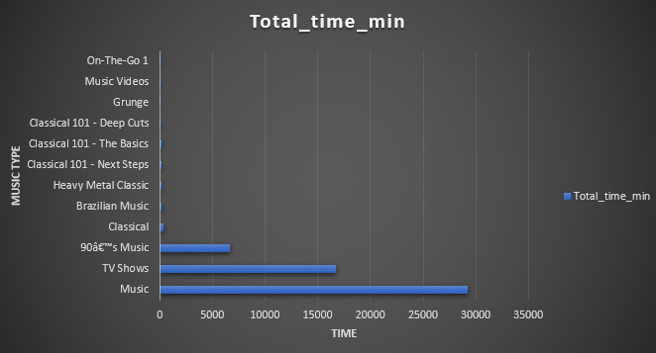
Most playlist period
We see from the following visualiztation evey playlist and the total time of this playlist. And we realize that the Music, TV Shows and 90â€™s Music have the most period than other plalists.
<visualization>

Slide 3
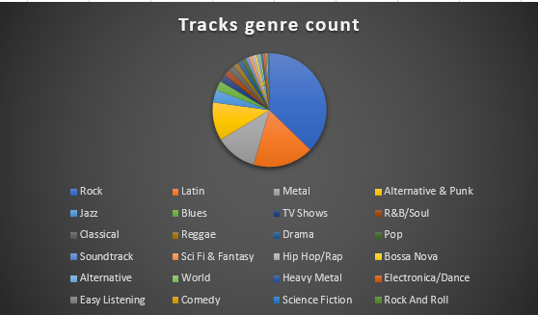
Genre for most tracks
<visualization>
if we do a query to understand the market of the songs we find that the Rock and Latin have the most percentage of the market.

Slide 4
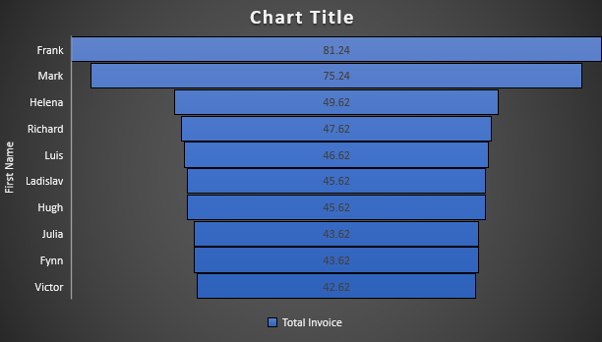
Who is the best customer ?
<visualization>
we see Frank and Mark are the best customers with the most spent on the songs market.

Slide 5
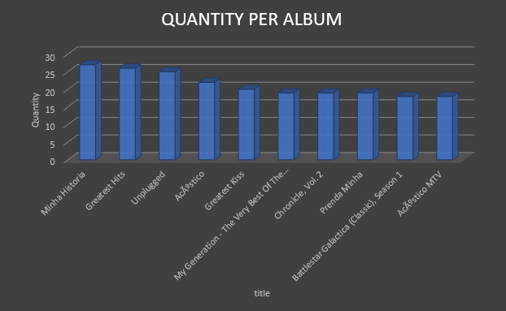
Top 10 Most album sold quantities
to check what the is the most sold albums we did this query which indicat that the Minha History and Greatest Hits have the most sold quantities.
<visualization>

